Slide 1
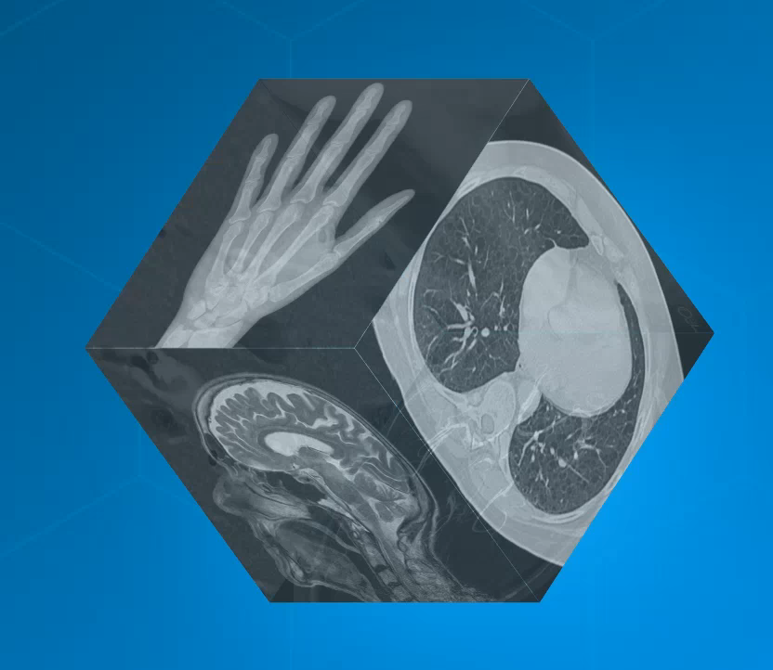
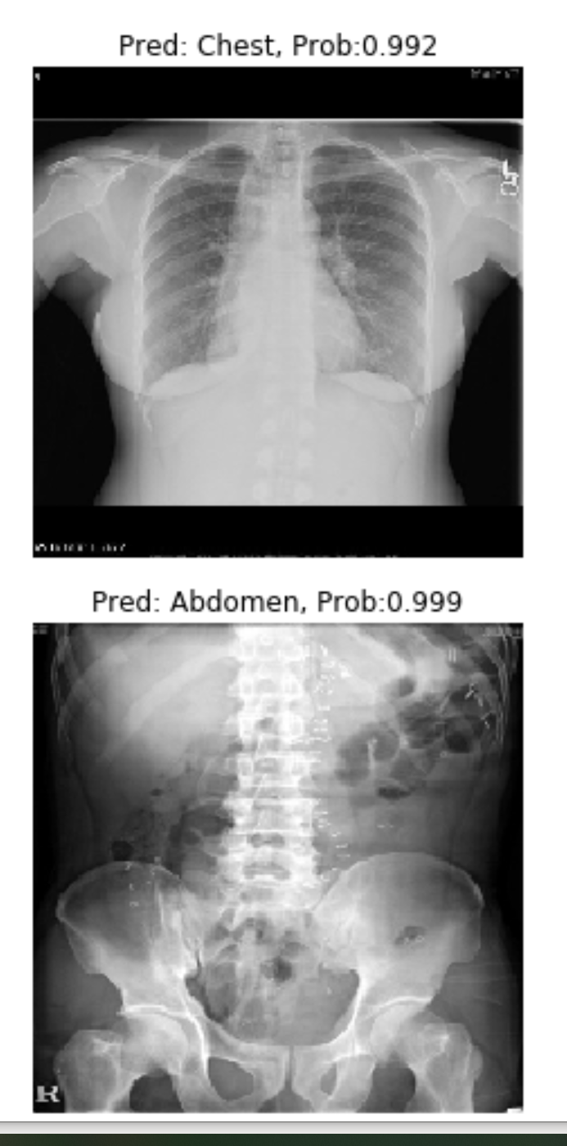
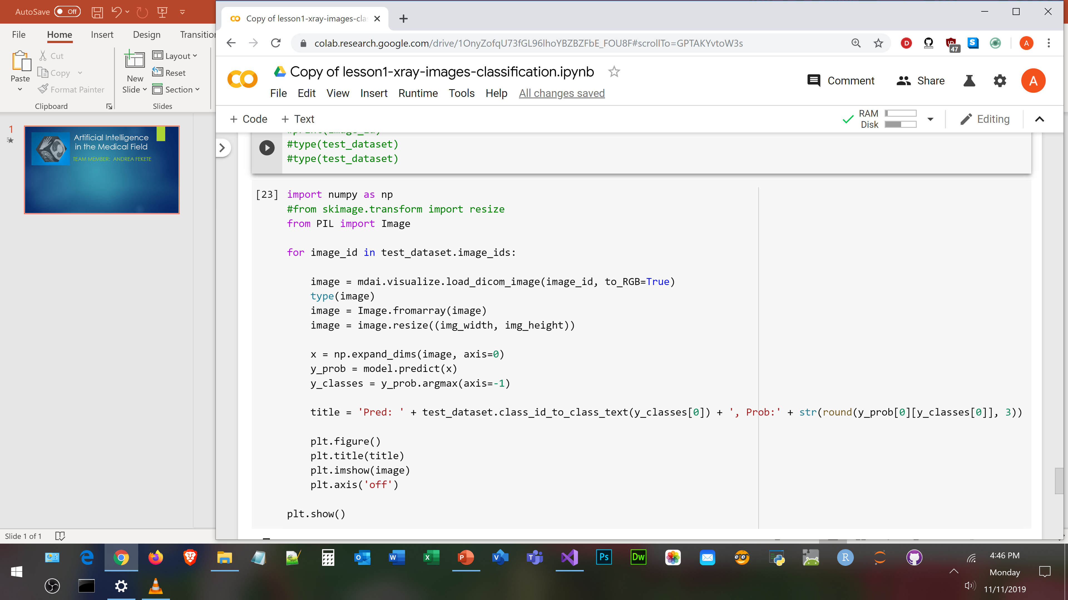
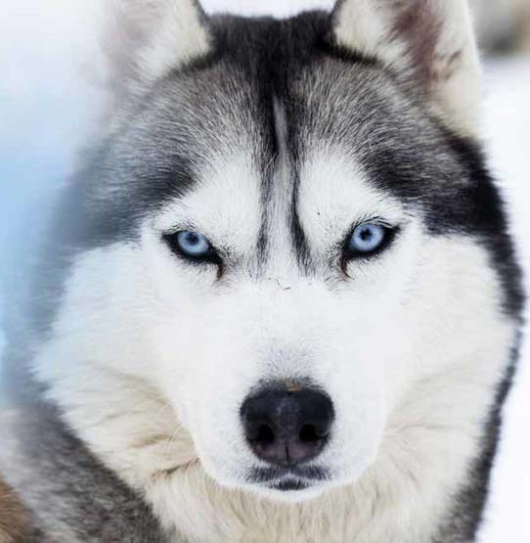
Utilizing Machine Learning for Image Recognition
Team Member: Andrea Fekete
The goal of this project is to show one way Machine Learning can benefit healthcare. The proposed project will modify publicly available Python code from the MD.ai website (MD.ai, n.d.). This code will run in Google’s CoLab using the TensorFlow Application Programming Interface . The intent of the project is to test the AI with an image that it is not really trained for and observe the results.
The code to the right displays two images from the test dataset and prints out the prediction and estimated accuracy of those predictions. Proper function of the network assumes either a chest x-ray or an abdominal x-ray as input. What would happen if we provide an image of a husky to the network? Will it show a low or a high prediction probability?
H₀: Providing a test image of a husky as input for the AI will not result in erroneous prediction and will show low probability score.
H_{a}: Providing a test image of a husky as input for the AI will result in erroneous prediction and will show high probability score.
Reference: MD.ai, n.d.
Image sources: MD.ai, n.d.; https://www.pets4homes.co.uk/pet-advice/siberian-husky-colours-and-commonly-confused-breeds.html
Code repository: https://github.com/ksu-hmi/Utilizing-Machine-Learning
Prediction: ?
Probability: ?

